Slide 1
Task Assignment:
HTML:
Francis J. Dula Jr.
David Anthony
CSS:
Francis J. Dula Jr.
David Anthony
JavaScript:
Francis J. Dula Jr.
David Anthony
JSON data:
Francis J. Dula Jr.
Group of
Francis J. DULA
&
David Anthony M. Vicada

Slide 2

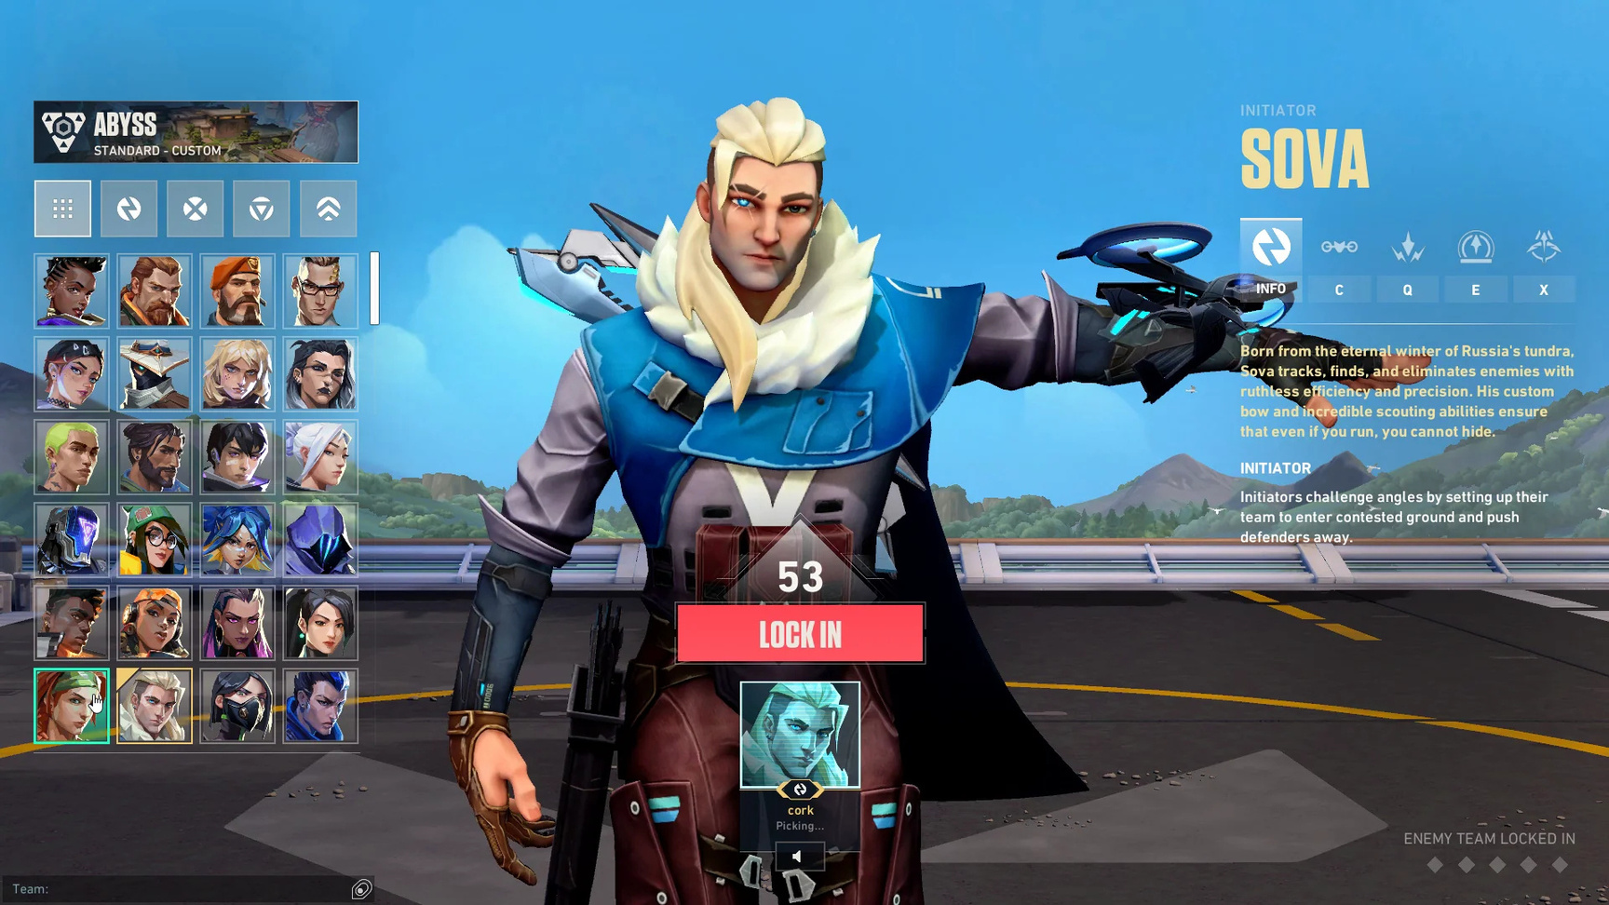
Valorant
Design Layout Inspiration:

Slide 3

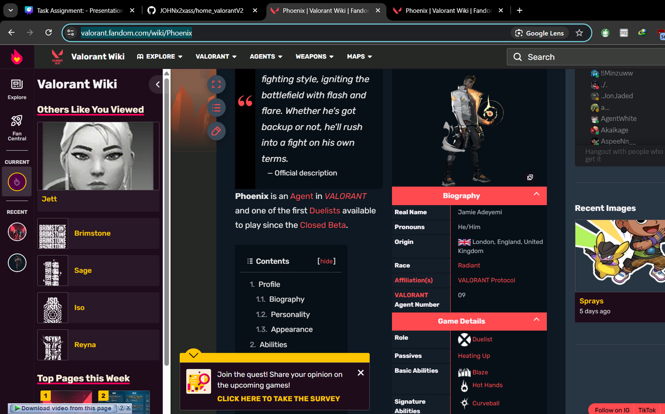
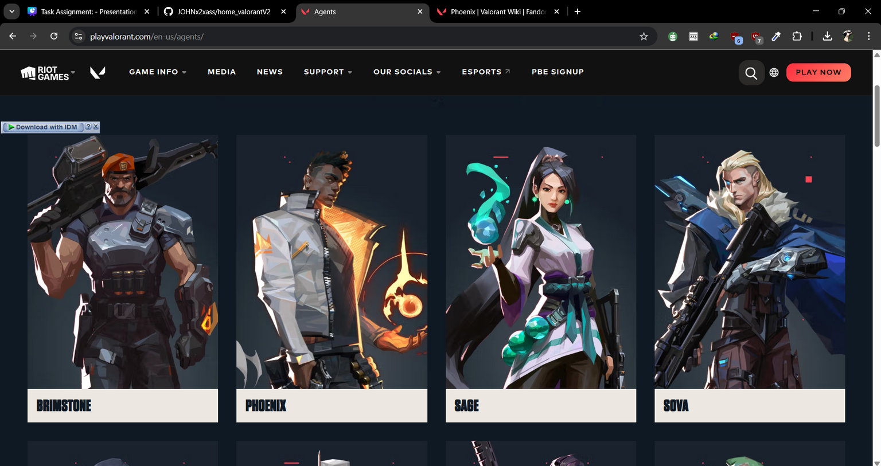
REFERENCES:
HTTPS://VALORANT.FANDOM.COM/WIKI/PHOENIX
HTTPS://PLAYVALORANT.COM/EN-US/AGENTS/

Slide 4

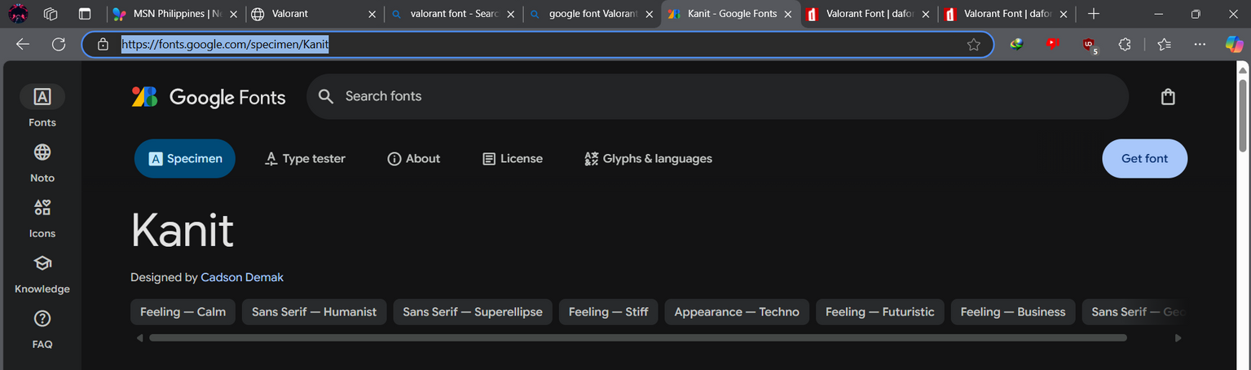
REFERENCE FOR FONT
HTTPS://FONTS.GOOGLE.COM/SPECIMEN/KANIT

Slide 5
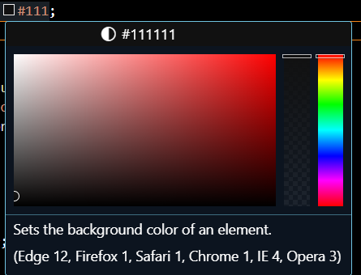
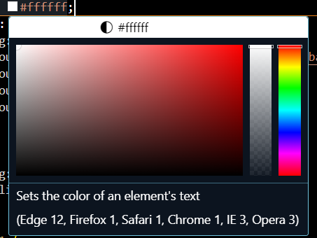
REFERENCE OF THE COLOR:
HTTPS://PLAYVALORANT.COM/EN-US/AGENTS/
USING THE COLOR OF THE ORIGINAL WEBSITE AND USE IT TO HAVE THE FEELS OF THE VALORANT.

Slide 6

THE CHALLENGES:
THE CHALLENGES:
Francis J. Dula Jr.
THE AGENT-LIST SECTION FACED CHALLENGES IN ENSURING PROPER RESPONSIVENESS AND ALIGNMENT OF AGENT CARDS WHILE MAINTAINING A VISUALLY APPEALING LAYOUT ACROSS DIFFERENT SCREEN SIZES.
THE SPECIAL ABILITIES SELECTION FACED CHALLENGES IN ENSURING A SEAMLESS USER EXPERIENCE, SUCH AS DYNAMICALLY DISPLAYING ABILITY DETAILS, MANAGING TRANSPARENCY EFFECTS, AND MAINTAINING RESPONSIVENESS ACROSS VARIOUS DEVICES.
David Anthony
I HAD TROUBLE USING AND MANIPULATING THE JSON FILE BECAUSE IT FEELS VERY SCATTERED AND SO I GAVE THAT PART OF THE PROGRAMMING TO FRANCIS DULA TO DO.

